Slide 1
NCFS Smart View
June 9, 2026

Slide 2



Smart View
Denise Langston
Business Systems Analyst
North Carolina Financial System
NC Office of the State Controller - OSC

Slide 3
Smart View - Course Objectives
What is Smart View
How to Install Smart View add-in
How to establish a connection
Example

Slide 4
What is Smart View
Oracle Smart View is an add-on to Microsoft Word, PowerPoint, and Excel.
Using Smart View, you can view, manipulate, and share data in Excel, Word, and PowerPoint interfaces. Smart View is a comprehensive tool for accessing and integrating Enterprise Performance Management, Business Intelligence, and General Ledger content from Microsoft Office products.
Smart View provides the ability to create and refresh spreadsheets to use real-time account balances and activity.

Slide 5
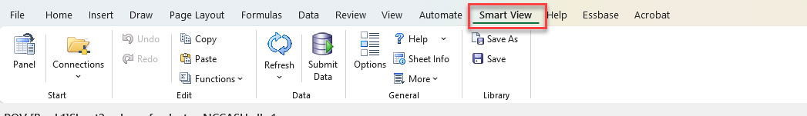
How to install Smart View
Close Microsoft products, specifically Excel, Word, PowerPoint, and Outlook
  Note: Teams and Edge can stay open
Navigate to OSC NCFS Year-End website and download files
Follow Steps in QRG
Double click SmartView.exe file
  File will automatically start download
  Select Run and follow prompts
Once complete open Excel to ensure you have the Smart View Ribbon

Slide 6
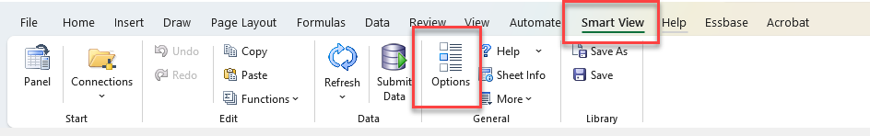
Establish a Connection
Now that you have the Smart View add-in downloaded, we need to establish a connection to the ERP system to see data. On the Smart View ribbon, select Options.

Slide 7
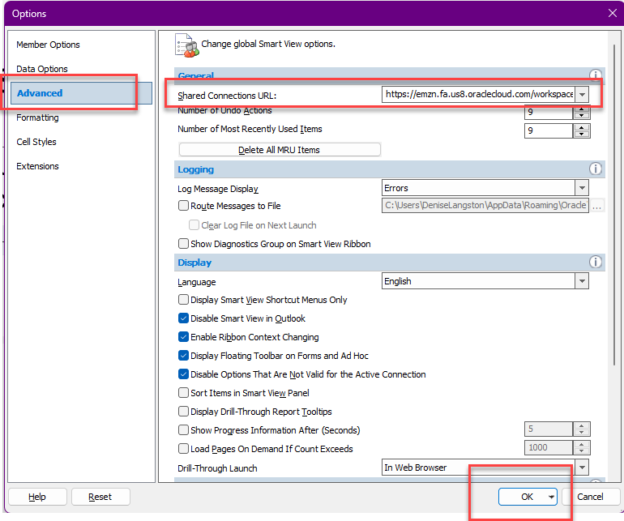
NCFS Sign In
Select Advanced.
Check the existing text in the Shared Connections URL field to determine whether it exactly match this URL: https://emzn.fa.us8.oraclecloud.com/workspace/SmartViewProviders
If not, copy this URL and paste it in the Shared Connections URL field.
Then, select the OK button.

Slide 8
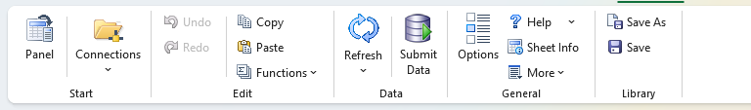
The Smart View Toolbar

Slide 9
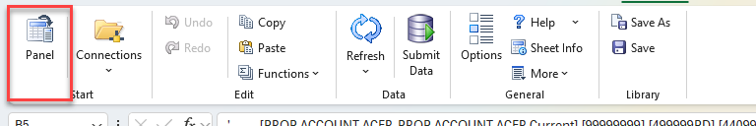
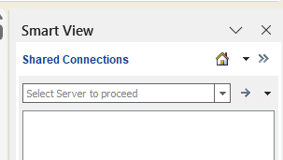
Smart View Panel
Panel – Opens Smart View panel on the left of the screen.
The Smart View panel is used to set a connection to established worksheets.

Slide 10
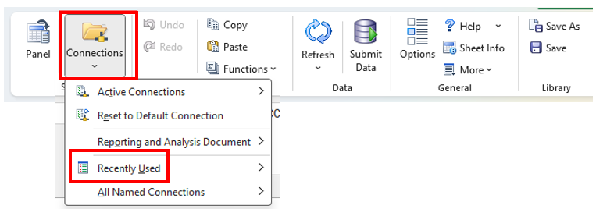
Smart View Connections
Connections – Dropdown includes all connections that have previously been made.
Note: Recently used is helpful to find recent connections if the worksheet losses connection.

Slide 11
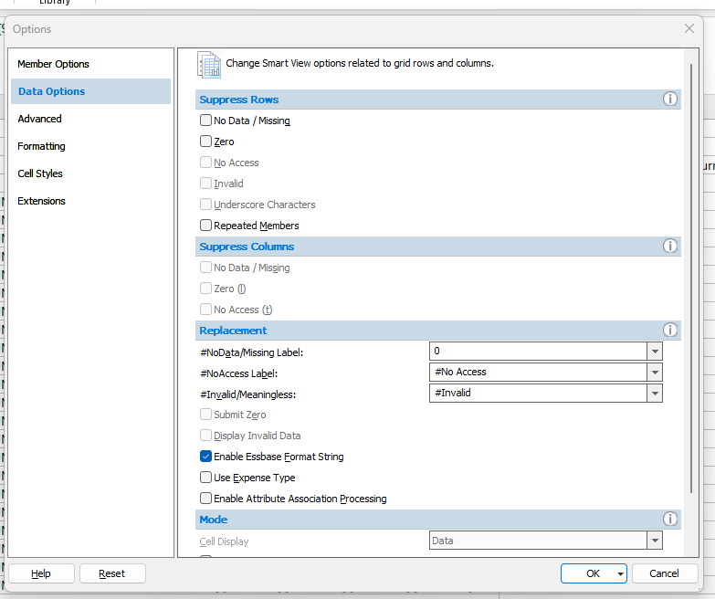
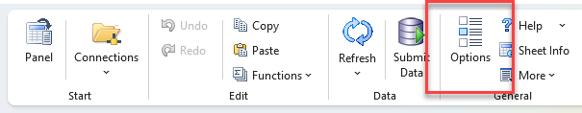
Smart View Options
Options – Opens another window with options on how to view data. We previously discussed this is where you add the URL for the Shared Connection to NCFS.
You can use this to Suppress Zeros for rows.

Slide 12
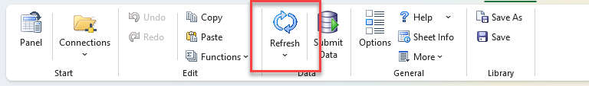
Smart View Refresh
Refresh – Refreshes the data to the database. This is extremely useful when making changes to dimension members or changing how you view the data.
When in doubt - refresh!

Slide 13
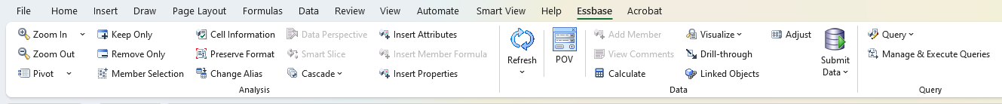
Getting to know the Essbase Toolbar
The Essbase toolbar is only available when a report is open, and the functionality is based on the specific report you are working with.

Slide 14
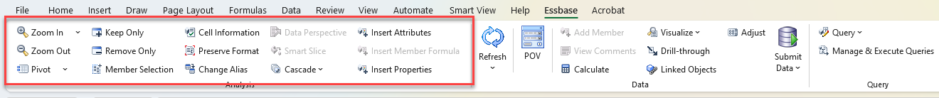
Essbase Toolbar Buttons
These buttons help you maneuver the data how you would like to see it. For example:
Zoom In and Zoom Out allow you to drill in and out of the data.
Pivot allows you to pivot dimensions from columns to rows or rows to columns.
Keep Only and Remove Only allow you to narrow your data to certain parameters.
Member Selection allows you to search for and add new members to customize the view.
Change Alias allow you to change how the data labels are viewed.

Slide 15
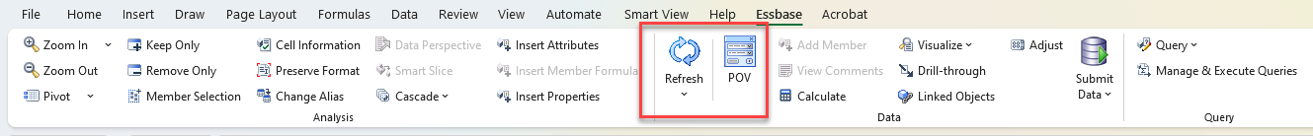
Refresh & POV
Refresh – Allows you to refresh the data feed after any changes have been made.
POV – Allows you to select dimensions to narrow your report view.

Slide 16
Example

