Slide 1
NCFS Insights
July 8, 2026

Slide 2

Welcome
Housekeeping
Introductions

Slide 3
Agenda
Welcome
Functional
Technical
Security
Training
User Engagement
Closing/Q&A

Slide 4
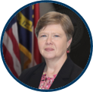
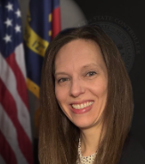
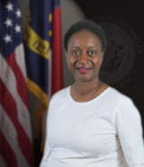

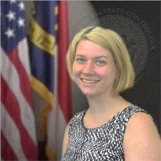
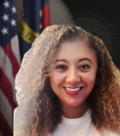
Presenters
Darlene Langston
Finance Manager
Jessica Mapes
Statewide Accounting & Financial Reporting Manager
Kim Battle
Statewide Accounting Financial Specialist
Frank Newsom
Business Systems Analyst
Laura Lee
OSC Training Lead
Lena Andrade
NCFS User Engagement Lead

Slide 5
Polling Question
Which reporting resources are most beneficial in your daily processes?
Pre-Built Reports
Smart View
Oracle Transactional Business Intelligence (OTBI)

Slide 6
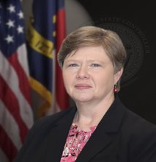
Presenter Spotlight
Darlene Langston
North Carolina Financial System
NC Office of the State Controller

Slide 7
July Key Dates
Flag AP Invoices for Accruals as needed in July.
FY27 Fixed Asset Freeze July 1st to July 28th - Final Day for FY26 Fixed Asset Data is July 26th.
Final Carryforward Request due to OSBM for Universities July 8th.
Final Carryforward Request due to OSBM for DPI and NCCCS colleges July 20th. OSBM approves Carryforward mid-July.
Approved Carryforward Transfer to OSC Agency 9000 July 20th.
UNC Institutions General Fund reversion posted to IBIS July 27th.
Agency General Fund Reversion posted to IBIS July 28th.
Final Day for June Intercompany Transfers July 30th.
June Cash Certification due July 31st.

Slide 8
General Fund Reversion Example 1
Reversions must be submitted in IBIS – Use the NC Allotments to Cash Availability (702) Report (RPT-BE-012) to identify the required entry.
Example 1:
For positive amounts in the Expenditures row, enter net negative expenditure allotment.
For positive amounts in the Receipts row, enter net negative receipt allotment.
For Assets/Liabilities/Equity, OSBM requires YTD equals zero at year end. Correct with journal entry.

Slide 9
General Fund Reversion Example 2
Example 2:
For positive amounts in the Expenditures row, enter net negative expenditure allotment.
For negative amounts in the Receipts row, enter net positive receipt allotment.
Net allotment (reversion) should be negative amount or zero.

Slide 10
General Fund After Reversion
After Reversion: The Unexpended YTD column values are all zero.
Guidance for entering reversion entries in IBIS can be found in OSBM’s State Agency Year-End Reversion Allotment Job Aid FY 2025-26.

Slide 11
Export ACFR Report Preference Update
Oracle has changed the default Excel download preferences for FRS reports in NCFS, this impacts the ACFR 11G, P & F, as well as 52G, 53P, and 54F.
To download the entire report to one tab in Excel, EACH USER will need to update preferences. The update is only required one time.
The Gen-16 Update Print Engine in the Financial Reporting Studio (FRS) QRG provides more details.

Slide 12
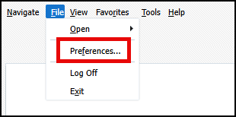
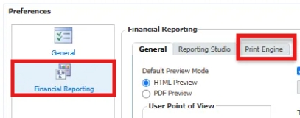
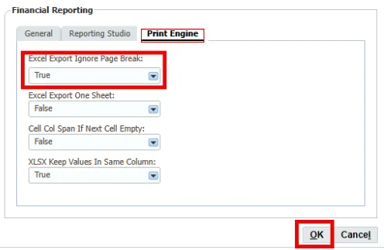
Report Preference Update Steps
In the Financial Reporting Center app in NCFS, open the Tasks pane and select Open Workspace for Financial Reports.
Select File, then Preferences to open your report preferences.
On the Preferences popup box select Financial Reporting and the Print Engine tab.
Select True under Excel Export Ignore Page Break.
Then OK.

Slide 13
Presenter Spotlight 2
Jessica Mapes and Kim Battle
North Carolina Financial System
NC Office of the State Controller

Slide 14
Capitalization Threshold Increase
Effective accounting date July 1, 2026.
Land, M&E, Art, and Gen. Infra increased from $5,000 to $10,000.
Buildings increased from $5,000 to $100,000.
Assets below new threshold – “retired” from FA module in FY2027.
For FY2027 ACFR financial reporting purposes, “retired” assets will be a current year deduction in FA module.
Asset Class | Current Capitalization Threshold | July 1, 2026 Capitalization Threshold
Buildings | $5,000 | $100,000
Land Machinery and equipment Art, literature, and other artifacts General infrastructure | $5,000 | $10,000
Internally generated computer software | $1,000,000 | $1,000,000
Other intangible assets | $100,000 | $100,000
Right-to-use – Buildings Right-to-use-Land Right-to-use – machinery and equipment Right-to-use – general infrastructure | $10,000 | $10,000
Subscription assets (SBITAs) | $400,000 | $400,000

Slide 15
Considerations for Changes
Federal Grant assets
If asset falls below new capitalization threshold, it will continue to be flagged as federally funded.
Monitor and track the “expensed” federal grant assets on the RPT-FA-10 report.
Building threshold increase
Assets below threshold will be on expensed assets list.
Majority of assets below $100,000 appear to be maintenance or repairs.
When coding capital outlay purchases, certain conditions must be met in determining whether it is considered maintenance/repair vs. additions/improvements to buildings.
OSC is clarifying policies related to buildings, additions, and maintenance.
Capital asset informational session coming in November/December.

Slide 16
Statewide Accounting Policy
Changes related to threshold increase:
102.01 – Capitalization/Classification
102.02 – Additions, Renovations, Improvements (under review)
102.04 – Libraries
102.08 – Buildings
102.14 – Capital Asset Policy Procedure Manual

Slide 17
Policies Under Further Review
For issues related to buildings and useful lives:
102.02 – Additions/Renovations/Improvements: Building components
102.03 – Maintenance: Repairs and maintenance
102.05 – Depreciation: Useful lives
Statewide Policy Directory - Capital Assets

Slide 18
Presenter Spotlight 3
Frank Newsom
North Carolina Financial System
NC Office of the State Controller

Slide 19
FY27 Capitalization Threshold Change
Beginning 7/28/26, first day of FY27 for Fixed Assets.
Effective for accounting date 7/1/2026.
Asset Class | Current Capitalization Threshold | July 1, 2026 Capitalization Threshold
Buildings | $5,000 | $100,000
Land Machinery and equipment Art, literature, and other artifacts General infrastructure | $5,000 | $10,000
Internally generated computer software | $1,000,000 | $1,000,000
Other intangible assets | $100,000 | $100,000
Right-to-use – Buildings Right-to-use-Land Right-to-use – machinery and equipment Right-to-use – general infrastructure | $10,000 | $10,000
Subscription assets (SBITAs) | $400,000 | $400,000

Slide 20
Capitalization Threshold Actions By OSC
During the FY26/27 Fixed Asset blackout period (July 27th),
OSC will:
Take a snapshot of all assets entered within NCFS at that time.
Update Capitalization Thresholds for all categories.
Update GASB book rules to perform based on the new threshold.
Retire all active and impacted assets (between $9,999.99 and $5,000) with Capitalization Threshold Change retirement reason.
OSC will not:
Update pending source lines to new asset type.
Re-add impacted assets as expense type.
  OSC will provide agencies with an impacted asset re-addition sheet. This will enable you to easily re-add these assets for tracking purposes as the expense type.
  OSC needs a point of contact to provide this re-addition sheet to per agency.

Slide 21
Year-End Fixed Asset Dates
Task | Task Description | Start Date | Complete By Date
Hold FY2027 Asset activity | No FY2027 asset transactions should be placed from 7/1 until 7/28 when the July period opens. Confirm the Depreciation period on your fixed assets dashboard shows Jul-26 before entering FY2027 data. | 7/1 | N/A
Review SBITA and Lease Asset Useful lives and Depreciation | Review your RTU Leave and SBITA assets on the NC SWCAP Assets Report (FA008) to verify the correct useful lives are used for these assets and their LTD depreciation is correct. Submit a help desk ticket (ncfs@ncosc.gov) to correct assets by July 23. Additional details can be found in FA-15 Adding an RTU Asset (Leased Asset) | N/A | 7/23
Fixed asset deadline | Last day to enter asset data for fiscal year is July 26. Year ending reports (Fixed Assets Outbound Interface to FCCS) are available. Agencies that miss this deadline should submit a help desk ticket to OSC. | N/A | 7/26
Fixed Assets clear exceptions | Clear all transfer, adjustment, and retirement exceptions by July 26. | N/A | 7/26
Asset retirements completed for FY2026 | Retirements must be completed by the 7/26 deadline. OSC does not have the ability to backdate these transactions. | N/A | 7/26
Asset transfers completed for FY2026 | Transfers to new accounts must be completed by the 7/26 deadline. OSC does not have the ability to backdate these transactions. | N/A | 7/26
Begin FY2027 asset activities | Asset transactions including additions, adjustments, transfers, and retirements for FY2027 assets can begin on July 28. | N/A | 7/28

Slide 22
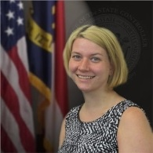
Presenter Spotlight 4
Laura Lee
North Carolina Financial System
NC Office of the State Controller

Slide 23
Training
GEN101 Decommissioned
ACC103 Published: Assets, liabilities, balance sheet, fund balance, and net position.
OTBI WBT: Focus group availability in July
OTBI Quick Reference Guides: Updated and available on the NCOSC website.
Note: For best NCFS performance, clear cache regularly and only use the Edge or Chrome browsers.

Slide 24
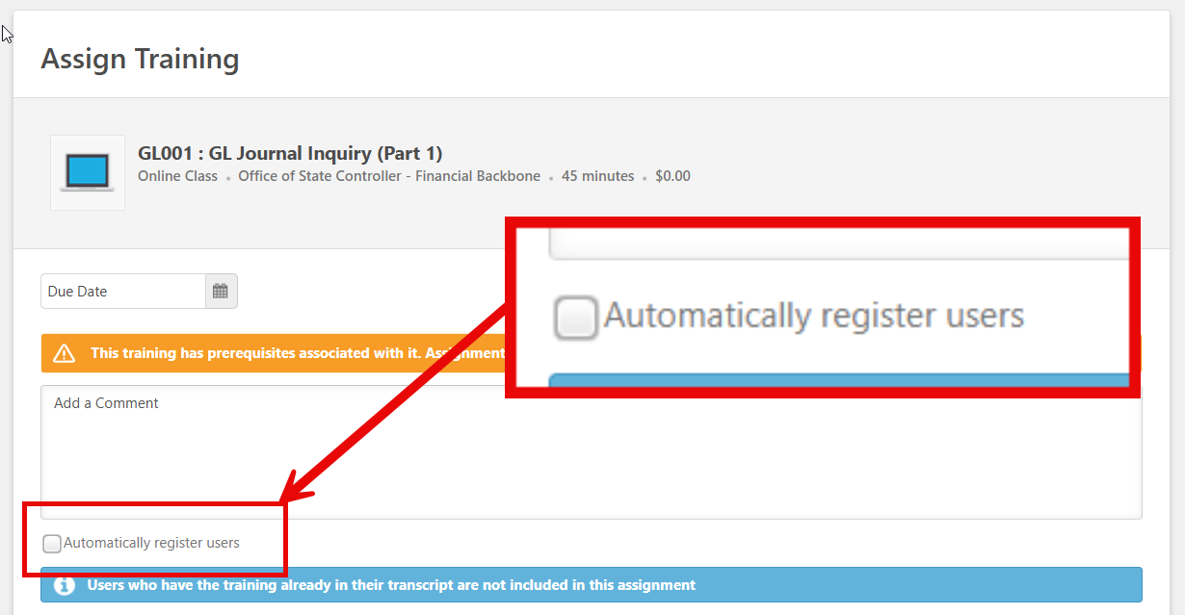
Exceptions
All LMS only exception requests are denied. Avoid LMS generated exception requests:
Request courses in order starting with the first prerequisite.
Supervisors: When assigning courses leave the “Automatically register users” checkbox deselected.

Slide 25
Presenter Spotlight 5
Lena Andrade
North Carolina Financial System
NC Office of the State Controller

Slide 26
What Is OTBI?
Oracle Transactional Business Intelligence (OTBI)
OTBI is a reporting tool within NCFS that enables users to create custom, real-time reports.
It sits on top of transactional data and ensures reports are connected to the latest system activity.

Slide 27
Oracle Fusion BI Author
Oracle Fusion BI Author is a specialized user security role and functional permission level within Oracle Transactional Business Intelligence (OTBI). It grants users the capability to design, build, and edit ad-hoc analytical reports, dashboards, and visualizations.
Key Capabilities:
Create Analyses: Build queries from scratch using drag-and-drop subject areas containing transactional data fields.
Build Dashboards: Group multiple analyses, prompts, and KPIs into interactive, multi-tab executive dashboards.
Configure Prompts: Design data filters that allow end-users to dynamically narrow down report results.
Manage Catalog Files: Save, organize, edit, and delete report objects within the shared corporate folder structure.

Slide 28
OTBI Next Steps
Determine who will need this role within your organization/department?
NCFS Users to complete the OTBI - NCFS User Request survey.
Early August Kick Off/Launch.

Slide 29
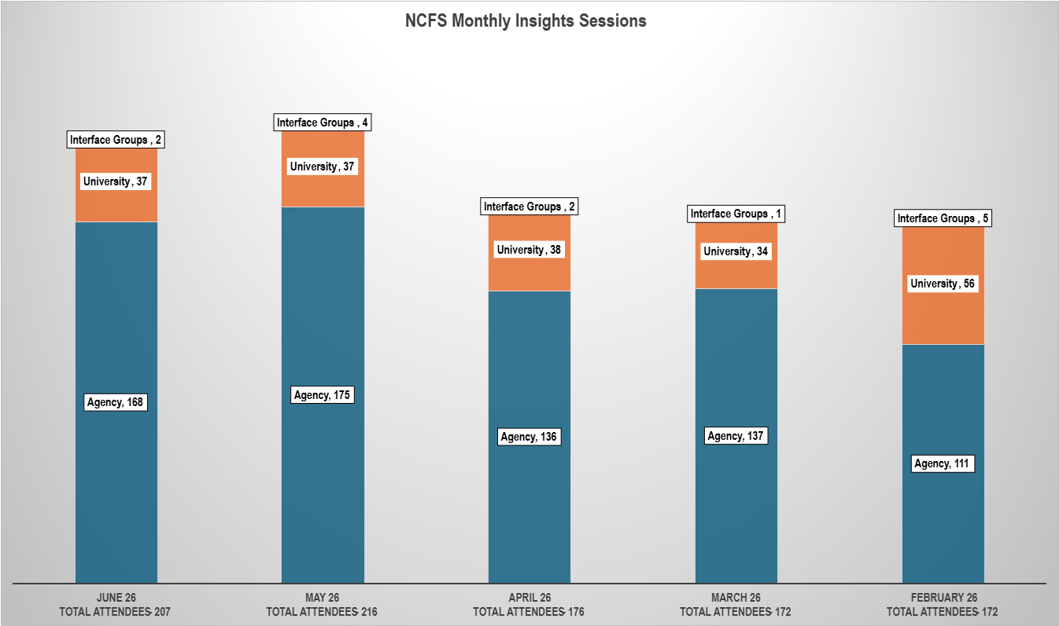
NCFS Insights Attendance

Slide 30
July 2026 Functional Calendar
Date | Actions, Deadlines, and Events
July 1 | NCFS Blackout Period Until Mid-Day July 1st Begin Flagging AP Accruals Close Subledgers for June Hold FY2027 Asset Activity until July 29th
July 3 | State Holiday
July 8 | NCFS Insights Session 1:00 – 2:00 PM
July 20 | Resolve Invoices On Hold
July 23 | Deadline For SBITA And Lease Asset Useful Lives
July 26 | Final Day To Enter FA Data For FY2026 Clear All Transfer, Adjustment, And Retirement Exceptions
July 28 | Begin FA Transactions For FY2026
July 30 | Final Day For June IC Transactions – Deadline 10:25 AM IC Module Closed For June Open IC Module For August
July 31 | June 2026 Certification Form Due June GL Journals Due By 10:25 AM Close GL for June Recommended That Accrual Entries Be Recorded By 8/1 Open GL & Subledgers For August PPRs July Deadline – 10:25 AM Correct ADFDI Invoice Import Errors By 3:30 PM

Slide 31
August 2026 Functional Calendar
Date | Actions, Deadlines, and Events
August 1 | Accrual Entries Should Be Recorded by 8/1
August 3 | Close Subledgers For July Finally Close POs That Won’t Be Invoiced Correct Invoices Incorrectly Keyed To Future Year PO Lines
August 5 | NCFS Insights Session 1:00 – 2:00 PM
August 14 | July 2026 Certification Deadline
August 17 | Resolve Invoices On Hold
August 28 | Final Day For July IC Transactions – Deadline 10:25 AM IC Module Closed For July Open IC Module For September
August 31 | July GL Journals Due By 10:25 AM PPRs August Deadline 10:25 AM Open GL & Subledgers For September Close GL For July Correct ADFDI Invoice Import Errors By 3:30 PM
August 1 | Accrual Entries Should Be Recorded by 8/1
August 3 | Close Subledgers For July Finally Close POs That Won’t Be Invoiced Correct Invoices Incorrectly Keyed To Future Year PO Lines

Slide 32
What’s Next?
ACFR Planning Conferences – May through July
NCFS Newsletter – July
Next NCFS Insights Session – Join on August 5th 1:00 pm - 2:00 pm.

Slide 33
Reference Links
2026 Communications Archives (Insights, Month End, and Fixed Asset Info)
Agency Year-End Info (User Checklist, AP Accrual Sessions)
GEN-16 Update Print Engine in the Financial Reporting Studio (FRS)
NCFS Change Request Intake Form
NCFS IC Contacts – Check your Agency/University/Interface Group and update if needed.
NCFS Functional Calendars
NCFS Gen-11 Reference Links
NCFS Help Documents
NCFS Pre-Built Reports
NCFS Production (Oracle Cloud)
NCFS Resources
NCFS Security Administrators
NCFS Security Roles
NCFS System Training
NCFS Year-End Resources
OTBI Quick Reference Guides
Reversion Allotment Entries Job Aid
Smart View Information (QRGs, Presentations, and Recordings)
Statewide Policy Directory - Capital Assets

Slide 34
Thank you
Thank you!
For questions or assistance, contact ncfs@ncosc.gov.

