Slide 1
NCFS Insights
October 7, 2026

Slide 2

Welcome and Agenda
Housekeeping
Introductions
Welcome
Functional
Training
User Engagement
Closing/Q&A

Slide 3

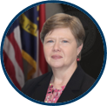
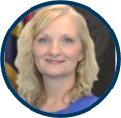
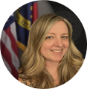
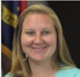
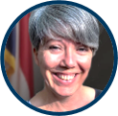
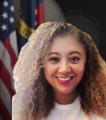
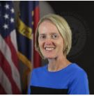
Presenters
Laura Klem
Deputy State Controller
Statewide Accounting
Darlene Langston
Finance Lead
Gwen Earp
Materials Lead
Jessica Wilkins
Data Maintenance Lead
Taylor Brumbeloe
NCFS Deputy State Controller
Dawn Parrish
Learning & Development Special Projects Coordinator
Lena Andrade
NCFS User Engagement
Lead
Jan Prevo
NCFS Project Coordinator

Slide 4
Polling Question
Which weather pattern matches your NCFS mood right now?
Sunny and Bright
Stormy
Cold and Cloudy
Foggy

Slide 5
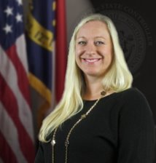
Presenter Spotlight
Laura Klem
North Carolina Financial System
NC Office of the State Controller

Slide 6
ACFR Update – FY 2026
Thank you! We appreciate agencies’ hard work, timely submissions, and continued partnership throughout the FY26 ACFR process.
MD&A Requests with GASB 103
  Selected agencies will receive targeted requests.
  Focus on significant changes/key drivers.
  Keep it simple and readable – use clear, nontechnical language that is understandable to a broad audience.
Standalone Financial Statements

Slide 7
ACFR Update – FY2027
Capital Asset Changes – upcoming training and guidance on changes impacting capital asset report
Earlier Engagement: Leases & SBITAs – exploring ways to identify and evaluate agreements earlier in the year rather than waiting until year-end
2026 OSC Financial Conference

Slide 8
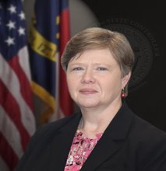
Presenter Spotlight 2
Darlene Langston
North Carolina Financial System
NC Office of the State Controller

Slide 9
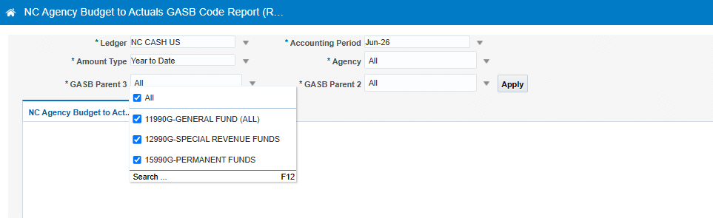
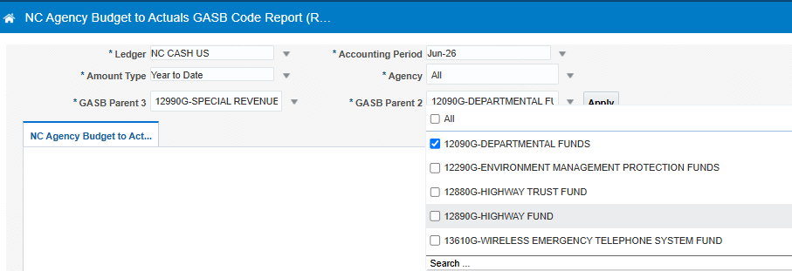
NC Agency Budget to Actuals GASB Code Report (RPTRTR191)
Report is designed to assist agencies that prepare stand alone audited financial statements and present budget to actual schedules as required supplemental information, additional analysis will still be required at the agency to prepare the report for publication. The report can be rendered for a governmental “Parent” GASB or a specific individual GASB fund.

Slide 10
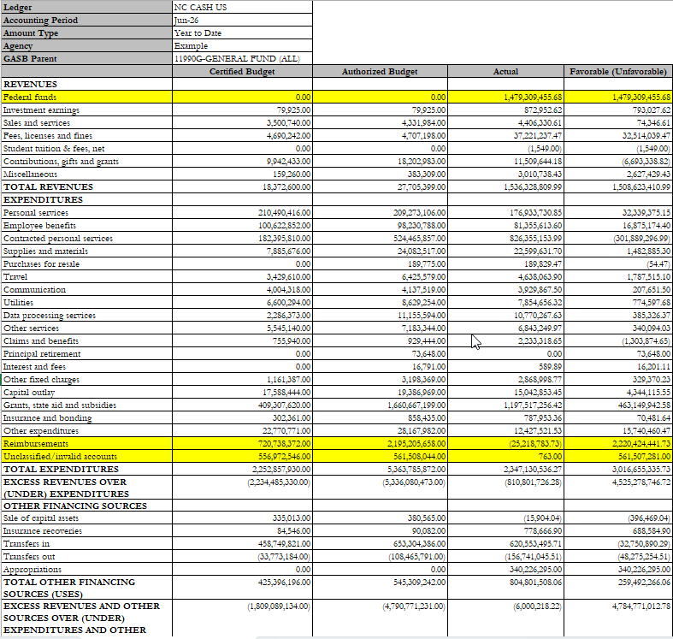
NC Agency Budget to Actuals GASB Code Report (RPTRTR191)-Example General Fund
For federal grants, the Actual amount is from the 421XXXXX account in the federal budget code, but the budget is in the 488XXXXX account in the general fund or other operating code. 488XXXXX accounts as well as 588XXXXX accounts are presented as Reimbursements because they net to zero for the ACFR. Agencies will need to review reimbursements as well as Unclassified/invalid accounts to determine the appropriate presentation for those accounts.

Slide 11
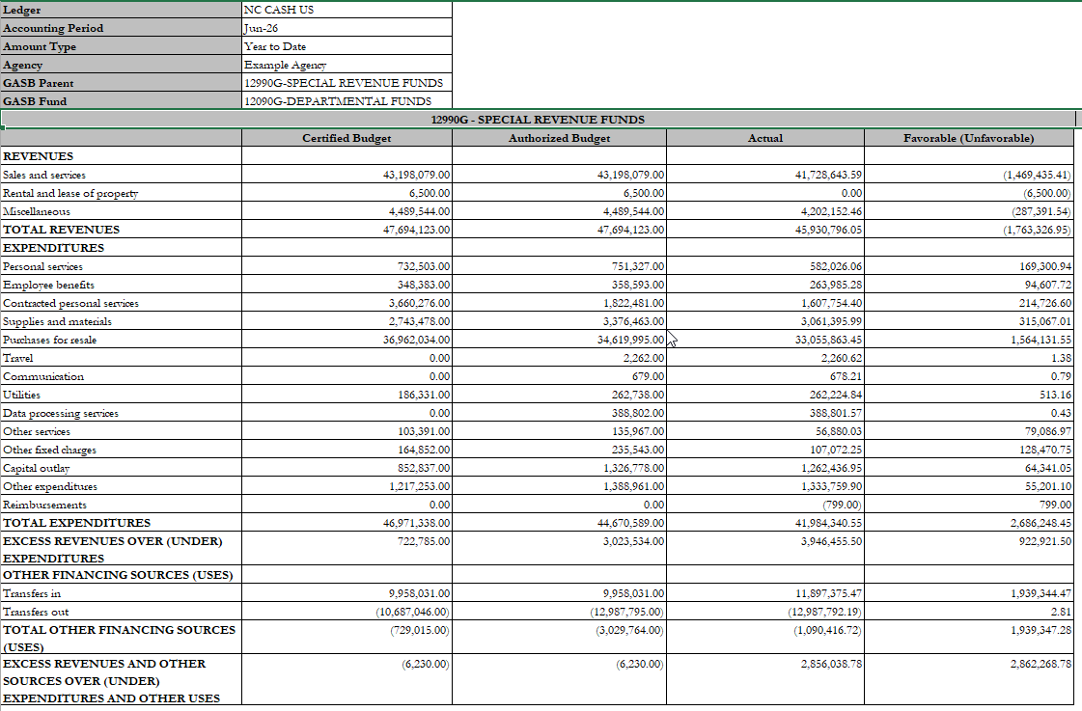
NC Agency Budget to Actuals GASB Code Report (RPTRTR191)-Example Special Revenue

Slide 12
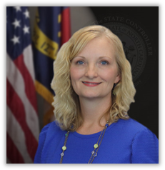
Presenter Spotlight 3
Gwen Earp
North Carolina Financial System
NC Office of the State Controller

Slide 13
Escheat Reminder
Outstanding NCFS check payments issued 7/1/24 to 6/30/25 should be escheated by November 1, 2026. OSC held an escheatment information session on Monday, September 28th. The slide deck, session recording, and ORG from that session can be found at NCFS Escheatment Process.
OSC Accounts Payable and Cash Management teams also reached out to several agencies who have uncleared NCFS and NCAS checks dated prior to 7/1/24 that have not yet been escheated. Agencies should work to escheat or re-issue these older outstanding checks as soon as possible. Please submit a ticket if you have questions about escheating these older outstanding payments.

Slide 14
1099 Reminder
OSC has been communicating with NCFS agency Chief Fiscal Officers regarding significant changes regarding 2026 1099 processing. All prior communications and session recordings can be found at 1099 Information.
Agency CFOs should have completed the TCC Application by September 30^{th .}
  Provide contact information for their agency’s Responsible Officials (ROs) and Authorized Delegates (ADs) to OSC by ticket submission.
  OSC will hold an information session for ROs and ADs later this calendar year that will cover exporting 1099 data from NCFS and uploading to the new IRIS portal.
Agency Accounts Payable staff should continue to flag invoices for 1099 reporting when applicable and use the RPT-AP-022 1099 Invoice Maintenance Report to validate accuracy throughout the initial 2026 1099 filing in January 2027.

Slide 15
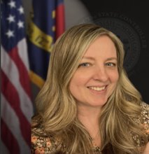
Presenter Spotlight 4
Jessica Wilkins
North Carolina Financial System
NC Office of the State Controller

Slide 16
ePay and Fraud Prevention Updates
ePay Phone Verifications are going well: 715+ phone calls since implementation in mid July.
Two new ePay documents are available on our website in the Electronic Payment Resources section.
  Best Practices for Supplier Payment and Banking Information Setup & Changes: Provides recommended practices for agencies when suppliers request payment or banking information changes.
  Responding to Suspected Supplier Payment Fraud: Outlines initial actions agencies should consider while coordinating with OSC and other appropriate parties.

Slide 17
ePay and Fraud Prevention Updates (continued)
Adding Account Verification Software to the ePay setup process in the near future.
Exploring the use of electronic signature software to replace the PDF version of the Supplier Electronic Payment Request form. The goal is to reduce sensitive information shared over email.

Slide 18
Supplier Registration Reminders
The Supplier Registration process is a joint effort between the Agencies and OSC. To make the process as smooth and efficient as possible, here are a few reminders:
  No punctuation in supplier name registrations or TAX ID/SSN/EIN numbers.
  Supplier names should be in all capital letters.
  Unless the supplier is an individual, the supplier type is “undesignated”.
  Please allow supplier registrations to be completed before entering a ticket. This is a multi-step process and may take a few hours to a few days depending on volume:
    TIN matching and initial approval – the first email Agencies receive
    Spend Authorization approval – the second email Agencies receive
    Site setup – the last step in the process (no email generated)

Slide 19
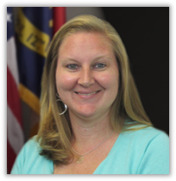
Presenter Spotlight 5
Taylor Brumbeloe
North Carolina Financial System
NC Office of the State Controller

Slide 20
OSBM BRIDGE Project – Go Live Update
Phase 1 – LIVE as of September 30th! Brings the base budget development process into Oracle. Everything else stays in IBIS for now and moves over when Phase II and Phase III goes live later in 2027.
What happens to IBIS:
  IBIS remains fully active for anything outside of Phase I base budget functionality (WSI and WSI Reports).
  Revisions, Allotments, Certification forms, Salary Control, etc. – all these functions will continue to be found in IBIS.
All Phase I Base Budget users are required to complete 3 BRIDGE training courses:
  Introduction to BRIDGE (BRI100) *Self-paced online
  Base Budget Creation and Adjustment (BRI200) *Instructor-led
  Budget Reporting (BRI300) *Instructor-led
Registration for training sessions is open in the Learning Management System (LMS).

Slide 21
OSBM BRIDGE Project
Phase 2:
Supports budget execution functionality
Currently working to build out through end of calendar year
Scheduled to go-live in July 2027
Phase 3:
Supports Governor’s Recommended Budget processes
Currently working to build out through end of calendar year
Scheduled to go-live in December 2027
Sign up for BRIDGE updates & report any questions or issues on the BRIDGE Budget System webpage!

Slide 22
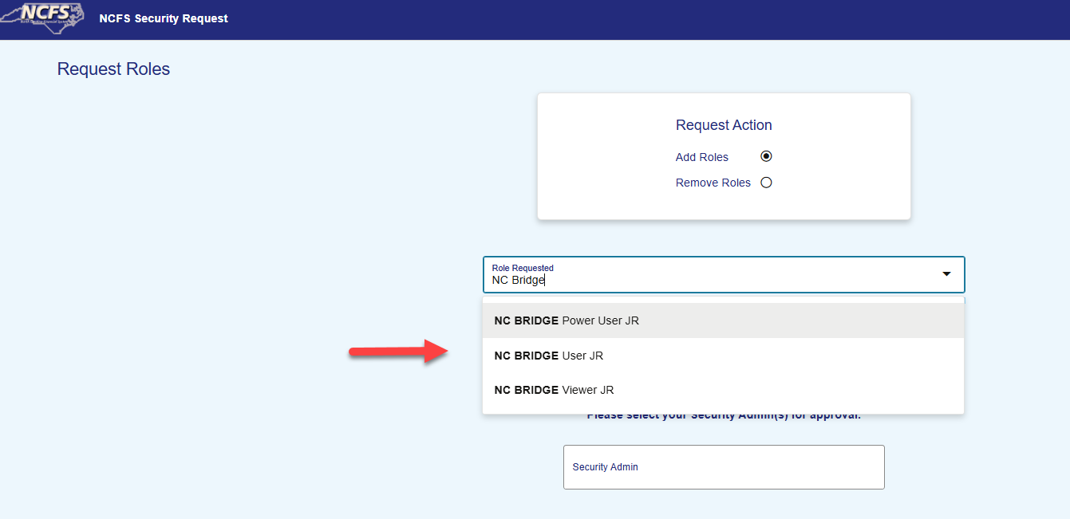
OSBM BRIDGE Project – Security Update
Steps for requesting BRIDGE Access for the New Employee
Contact your Agency Security Administrator to submit security request. OSC will then add the user to the OSBM Training Instance.
Register for the Bridge Classes BRI100, BRI200 and BRI300.
Once ALL 3 classes are taken, OSC will add you to the Production Bridge Instance. (This will take an overnight process.)
Note: If you have already taken the classes during the implementation, you will ALREADY have access at Go-Live, also the “NC BRIDGE Power User JR” is for OSBM only.

Slide 23
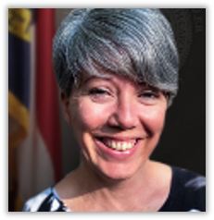
Presenter Spotlight 6
Dawn Parrish
Communications/Learning & Development
NC Office of the State Controller

Slide 24
Training
Virtual Training Process
  You request a class in LMS.
  Your manager approves the request in their LMS inbox.
  Instructor sees your name on the roster.
  Instructor emails information to join the class (about a week out).
  You join the class about 10 minutes early to check sound/mic.
  Make sure you have access to VPN.
Communicate with OSC Training Team:
  Email: osc.training.team@ncosc.gov
  Contact Us | NCOSC
  Email your instructor directly

Slide 25

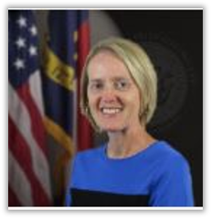
Presenter Spotlight 7
Lena Andrade
Jan Prevo
North Carolina Financial System
NC Office of the State Controller

Slide 26

Fall Engagement Touchpoints
Fall Touchpoints (54) are being held with NCFS Users from September – October across Agencies and Universities.
Agency touchpoints are 91% completed.
Invitations for Interface groups have been sent – begin 10/12: NCFS Interface Touchpoint Pre-Meeting Survey.

Slide 27
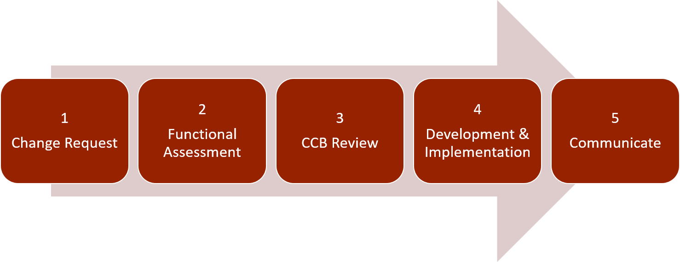
NCFS Change Request Intake Form
The NCFS Change Request Intake form is intended for system enhancement or change requests that do not currently exist in NCFS. Examples include new reporting or new interface functionality with an agency.
Please submit all items which you believe deserve a Change Request for NCFS.
If you need to include any attachments to your request or have questions on the status of a submitted request, please email NCFS.CCB.Support@ncosc.gov. Please reference the Change Request ID number provided in the “Requestor Email” submitted with the Intake Form.

Slide 28
NCFS Change Request Status
Status | Description
New | CCB requests are assigned this status upon creation.
Open | Indicates the request has been received by the NCFS team and initial work has begun. Open status indicates a yet-to-be-approved request.
Approved | Assigned to requests that are accepted and fully approved. Work on the Change Request may begin.
Denied | Request is rejected and closed after review by the Change Control Board.
Completed | Assigned at completion of the request. Indicates request was approved and fully implemented.
Deferred | Indicates item is approved but not actively being worked due to time constraints, lack of information, or other.
Deferred - Not Approved | Indicates the request is not approved and not being actively worked upon due to time constraints, lack of information, or other.
Stalled | Indicates the request is approved but not progressing due to circumstances outside of the NCFS team’s control.
Not CCB | Indicates the item should not have been made into a Change Request. Request is closed and incomplete.
Duplicate | Indicates the request already has a Change Request ID or is similar enough to another request. Requests marked as “Duplicate” are closed, though the original may be in an active status.

Slide 29

NCFS Fall 2026 Newsletter
Escheat Reminders
1099 Updates
Touchpoints
Supplier Best Practices
BRIDGE Info
Redwood Changes
Year-End Recap
OTBI
NCFS Newsletter – Coming this month!

Slide 30
NCFS Insights Attendance

Slide 31
October 2026 Functional Calendar
October 1
Begin Escheats activities in accordance with DST guidelines
Close Subledgers for September
October 5
Correct invoices incorrectly keyed to future year PO lines
Finally Close POs that won't be invoiced
October 7: NCFS Insights Session 1 PM - 2 PM
October 14: September 2026 Certification Deadline
October 19: Resolve invoices on hold
October 29
Final Day for September IC Transactions Deadline 10:25 AM
IC Module Closed for September
Open IC Module for November
October 30
Close GL for September
Correct ADFDI Invoice Import Errors by 3:30 PM
Open GL for November
Open Subledgers for November
PPRs October deadline 10:25 AM
September GL Journals due by 10:25 AM
Key:
Green = Subledgers - Accounts Payable, Fixed Assets, Inventory, and Accounts Receivable
Light Blue = General Ledger and Cash Management
Dark Blue = Fixed Assets
Purple = NCFS Insights and Information Sessions
Red = State Holiday
Brown = 2026 ACFR
Calendars can be viewed as a monthly, weekly, or list view.

Slide 32
November 2026 Functional Calendar
November 2
Close Subledgers for October
Correct invoices incorrectly keyed to future year PO lines
Finally Close POs that won't be invoiced
November 4: NCFS Insights Session 1 PM - 2 PM
November 11: Veterans Day
November 16
October 2026 Certification Deadline
Resolve invoices on hold
November 25
Final Day for October IC Transactions Deadline 10:25 AM
IC Module Closed for October
Open IC Module for December
November 26 & 27: Thanksgiving
November 30
Close GL for October
Correct ADFDI Invoice Import Errors by 3:30 PM
October GL Journals due by 10:25 AM
Open GL for December
Open Subledgers for December
PPRs November Deadline 10:25 AM
Key:
Green = Subledgers - Accounts Payable, Fixed Assets, Inventory, and Accounts Receivable
Light Blue = General Ledger and Cash Management
Dark Blue = Fixed Assets
Purple = NCFS Insights and Information Sessions
Red = State Holiday
Brown = 2026 ACFR
Calendars can be viewed as a monthly, weekly, or list view.

Slide 33
What’s Next
Session | Date | Time
NCFS Insights Session | November 4, 2026 | 1:00 – 2:00 PM
NCFS Fall Touchpoints | September – October 2026
2026 OSC Financial Conference | December 2026
Reference Links
BRIDGE Updates
BRIDGE Webpage
1099 Information
Best Practices for Supplier Payment and Banking Information Setup & Changes
Change Request
Electronic Payment Resources
NCFS.CCB.Support@ncosc.gov
NCFS Escheatment Process
NCFS Newsletter
Responding to Suspected Supplier Payment Fraud

Slide 34
Thank you
Thank you!
For questions or assistance, contact ncfs@ncosc.gov.

