Slide 1


NCFS Logo Opening

Slide 2
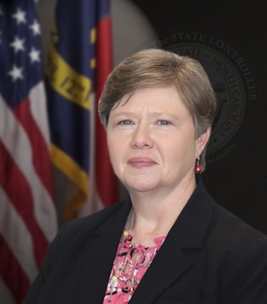

NCFS Accrual Information – General Ledger
Darlene Langston,
NCFS Finance Manager
North Carolina Financial System
NC Office of the State Controller - OSC

Slide 3
Accruals in NCFS

Slide 4

Accrual Ledgers in NCFS
Modified Accrual and Accrual are Secondary ledgers and are independent of each other so accrual entries will need to be recorded in both the NC ACCRUAL US and NC MODIFIED ACCRUAL US ledgers.
Accrual Ledger
Cash Ledger
Modified Accrual Ledger
Modified Accrual Ledger
Cash Ledger
Accrual Ledger

Slide 5

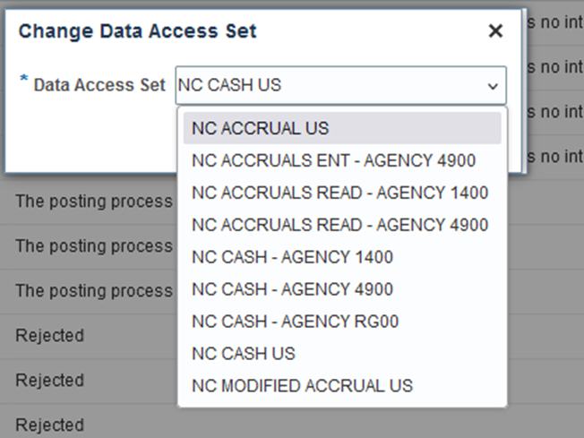
Accrual Ledgers (continued)
Change to the appropriate ledger in the Data Access Set.
For Accrual Entry, Select NC ACCRUALS ENT – AGENCY XXXX
  Agencies may have NC ACCRUALS ENT or NC ACCRUALS READ options.
  Agency access is determined by security roles. NC ACCRUAL ENT is for journal entry in either the Accrual or Modified Accrual ledger.
  NC ACCRUAL READ is for users with inquiry only in both accrual ledgers.

Slide 6
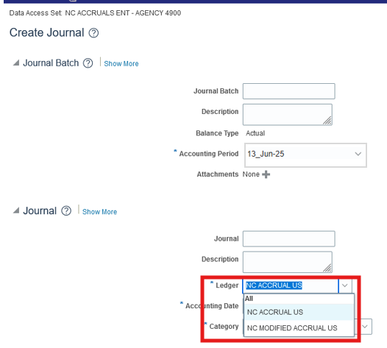
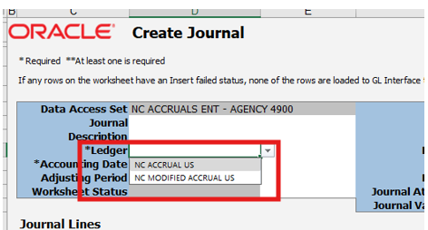
Enter Accrual Journals
Confirm your Data Access set - You can select either the NC ACCRUAL US or NC MODIFIED ACCRUAL US in the Ledger field on the Create Journal page in NCFS or in the Create Journal spreadsheet.

Slide 7
Accrual Entry Lessons Learned
  Accrual entries should be recorded in the 13_Jun-26 period.
  Journals with NC AGY REVERSING ACR category should not be used in the Jun-26 period because they will reverse in 13_Jun-26 period.
  Do not record any entries to cash 11120000 in the 13th period or directly in the accrual ledgers.
  Do not record accruals in the NC CASH US ledger.
  Do not use DEP or PAY category entries in the accrual ledgers.
  When using the spreadsheet upload to record accruals, the Data Access Set in NCFS should be NC ACCRUALS ENT – AGENCY XXXX prior to downloading the spreadsheet.

Slide 8
Accounts Receivable in NCFS
  NCFS does not have an automated process to inject accruals.
  Agencies should review receipts posted in July and record manual accounts receivable accrual entries as needed.
  If a subsystem is used for billing, accounts receivable balances from the subsystem may be the most appropriate way to determine receivable accrual entries.

Slide 9
Accounts Payable Mail Service Center
Since the Mail Service Center payments are interfaced monthly as an intercompany (IC) transfer, agencies will not have the option to add accrual indicators.
  OSC will summarize the IC entries and provide the accrual to the agencies.
  Agencies will need to review entries for accuracy and record the entries in the accrual ledgers.

Slide 10
New Accrual Indicators
NCFS requires that an interfund be used on Interfund Payable accounts
To facilitate the AP journal upload we have created 6 new AP indicators for high volume payables to other state agencies.
These accrual indicators have been mapped to the appropriate inter-governmental payable account and interfund
Accrual Indicator | Interfund Segment
A70 | 21241500 Iner-Gov’t Payable – Due to DOA Motor Fleet Mgmt
A71 | 21241500 Iner-Gov’t Payable – Due to DOA Temp Solutions
A72 | 21241500 Iner-Gov’t Payable – Due to DIT Telecommunications
A73 | 21241500 Iner-Gov’t Payable – Due to DIT Computer Services
A74 | 21241500 Iner-Gov’t Payable – Due to Correction Enterprises
A75 | 21241500 Iner-Gov’t Payable – Due to OSC Workers’ Comp

Slide 11

NCFS Procure to Pay
Gwen Earp
NCFS Materials Manager
North Carolina Financial System
NC Office of the State Controller - OSC

Slide 12
Accounts Payable Accruals in NCFS

Slide 13
Accounts Payable Accruals in NCFS
2 Categories of AP Invoice Accruals
Invoices Created and Validated but Unpaid at EOD June 30th
Invoices Created after July 1st

Slide 14
Accounts Payable Accruals in June

Slide 15
Accounts Payable June Accruals (2 of 3)
Invoices entered and validated but unpaid by 3pm on June 30th will post to a default liability account.
  Supplier Invoices default with the liability account on the supplier record.
    Most suppliers are set up with the standard 21110000-Accounts Payable (A10) default.
    Some suppliers that we identified in the following categories were updated on the supplier record with the following default liability accounts:
      NC Local Government/School Systems 21131000 (A16)
      Federal Government 211320000 (A17)
      Out of State Government/School Systems 21132500 (A15)
  Party Payments default with 21110000-Accounts Payable (A10).
  Employee Reimbursements default with 21111000-Due to Employees (A11).
Unpaid Invoices must be in a validated status to be accounted to the accrual ledger.
Please ensure unpaid invoices keyed into NCFS by 3pm June 30th are in a validated status to be picked up for default accrual in June. Users can look for unvalidated invoices in the "Invoice Validation Status" column of the Unpaid Invoice Status Report RPT-AP-048.

Slide 16
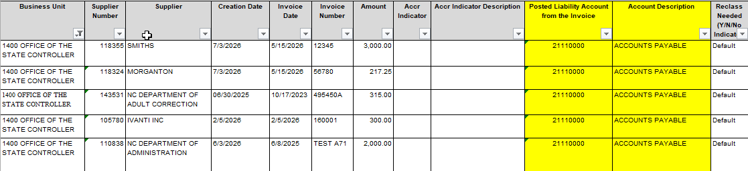
Accounts Payable June Accruals (3 of 3)
Agencies should review AP invoices keyed through June to verify the system generated default accruals are correct.
NC AP Accrual Reclass Report (Prior Year Invoices) RPT-RTR-172 to assist with review.
Report will have 2 tabs: Tab 1 will display all unpaid invoices as of June 30th with the default posted liability account from the invoice and account description for agency review.

Slide 17
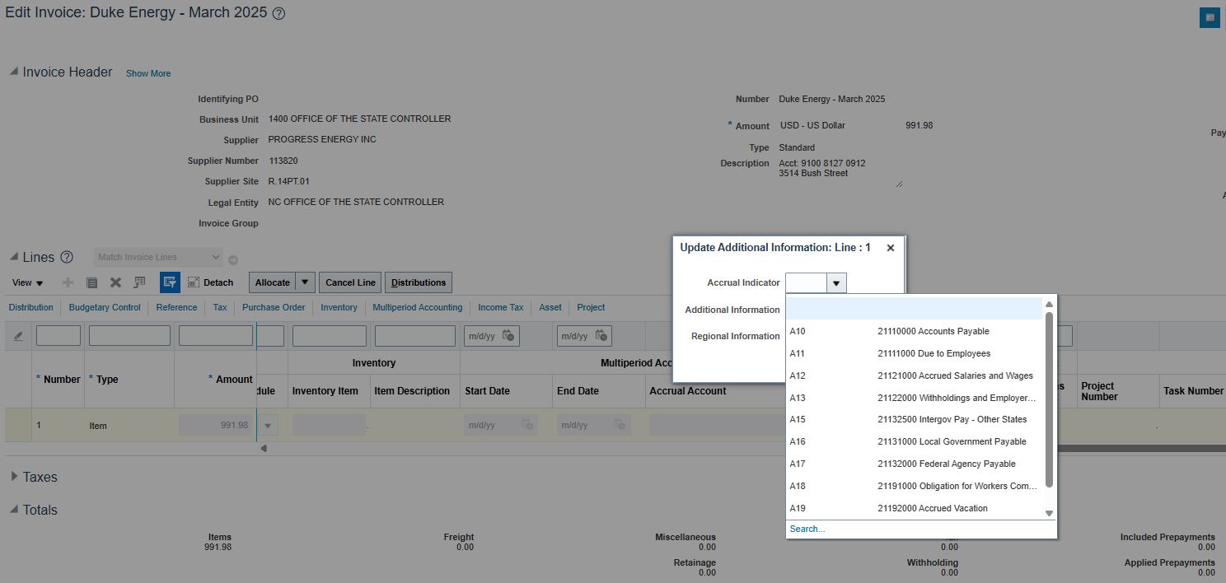
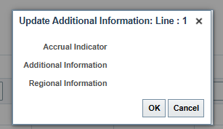
Accounts Payable Accrual Indicators
If default liability account is not accurate or one of the newly created accrual indicators is appropriate, agencies can manually add an accrual indicator to the invoice line. Quick Reference Guide (QRG): AP-43 AP Year-End Accrual Process
Accrual indicators can be updated before or after an invoice is paid, however, the system will not allow updates while the invoice is pending payment in a PPR. In these instances, the indicator dropdowns won't be available for selection. Indicators will re-appear for selection once the PPR is completed.

Slide 18
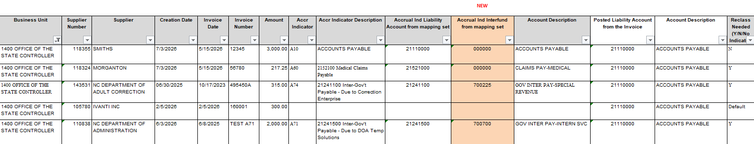
Accounts Payable June Accruals
Once accrual indicators have been updated on the invoice to the correct liability account, agencies should re-run the RPT-RTR-172 report and review report Tab 1 again to ensure accuracy.
Agencies can submit a Helpdesk ticket to request OSC update the Supplier default liability account for future use. OSC will analyze supplier use across all agencies to determine if default should be updated.

Slide 19
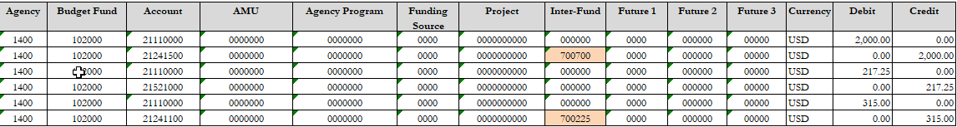
Accounts Payable June Accruals
Tab 2 of the report will display the information necessary for the reclass entry in the format that can be copied and pasted to the journal upload template.
Agencies should use NC AGY REVERSING ACCR journal category and record the journal in both the NC ACCRUAL US and NC MODIFIED ACCRUAL US ledgers.

Slide 20
Accounts Payable Accruals in July

Slide 21
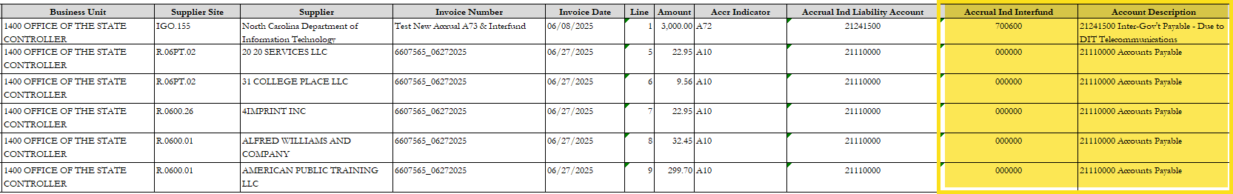
Accounts Payable July Accruals (1 of 2)
Agency AP staff should enter an accrual indicator on all invoice lines keyed in July for June goods and services.
This will be used to “flag” an invoice line for accrual and generate the necessary information for the accrual entry in the July AP Accrual Report.
NC AP Accrual Injections Report (After Year-End) RPT-RTR-177 will have two tabs: Tab 1 will display detailed invoice information for all invoices entered in July. Invoice lines with an accrual indicator will populate the accrual account and description as shown below for your agency to review. During the agency review, if errors are detected the Accrual Indicator (DFF) entered can be changed on the invoice line and the report can be generated again for additional review to ensure accuracy.

Slide 22
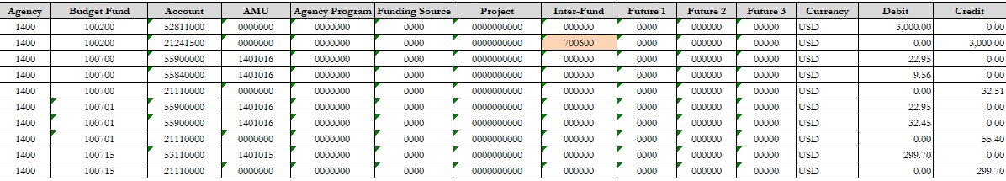
Accounts Payable July Accruals (2 of 2)
Tab 2 of the report will summarize by account combination and create a corresponding entry to the liability account and interfund if applicable in the format that can be copied and pasted to the journal upload template.
Agencies should use NC AGY REVERSING ACCR journal category and post to both the NC ACCRUAL US and NC MODIFIED ACCRUAL US ledgers.
Note that for the new accrual indicators, the Interfund is populated for you, if you have other interfund payables, you will need to manually add the interfund or the upload will fail.

Slide 23
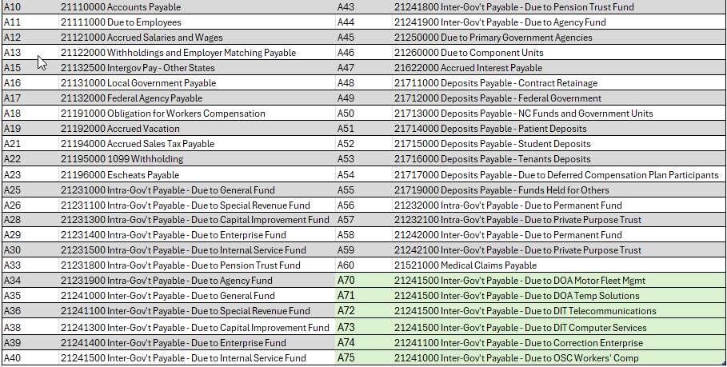
Accounts Payable New Accrual Indicators

Slide 24
AP Accrual Special Considerations

Slide 25
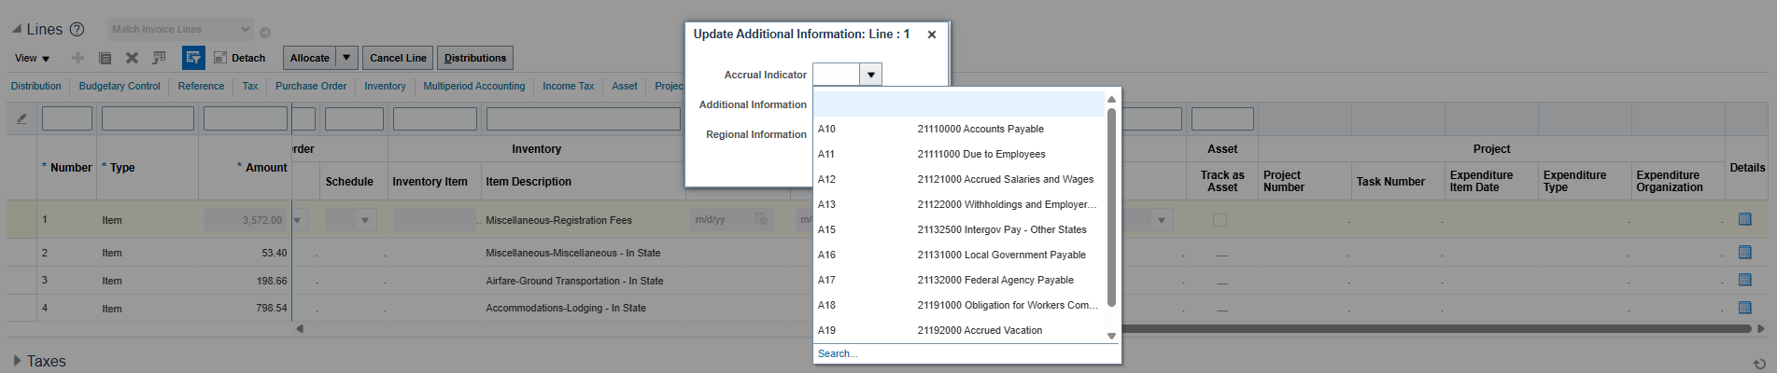
Employee Expenses
Employee Expenses must be manually tagged once the expense report is transferred to AP. This can be done before or after payment but not while pending payment in a PPR.

Slide 26
Invoice Interface
Invoice Interface INT-AP-002
This interface is set up to receive Accrual indicators on the invoice line in the interface.
If your agency subsystem is sending accrual indicators for the first time this year, please don’t wait to test sending the indicators. Please email ncfs@ncosc.gov to request testing of accrual files in a lower environment as soon as possible.
Capturis agencies should work with Capturis to send accrual indicators when required.
Accrual indicators can also be updated on the invoice line manually once the invoice is interfaced.

Slide 27
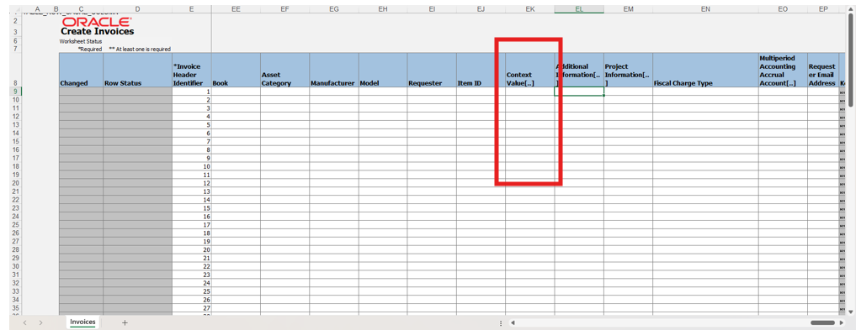
Create Invoice from Spreadsheet (1 of 2)
The ADFDI Invoice Upload allows for upload of the accrual indicators with the invoice information in column EK.

Slide 28
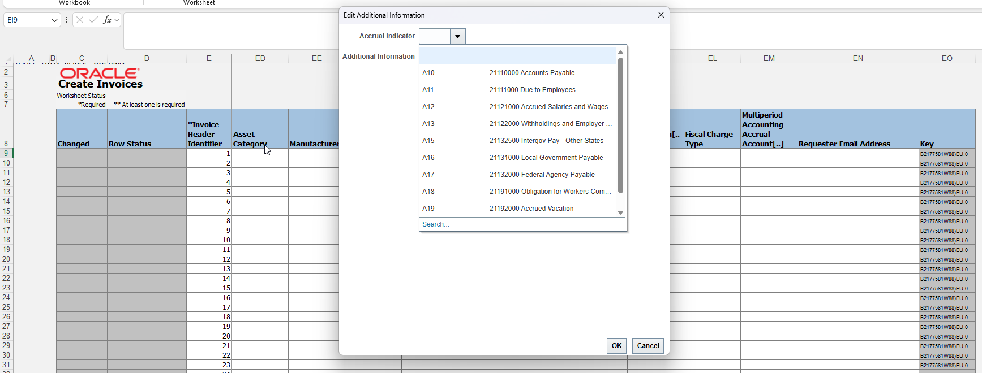
Create Invoice from Spreadsheet (2 of 2)
Double click on column EK, and you will be able to select from a list of valid values.

Slide 29
Party Payment Interface
INT-AP-030 - NEW for July 2026
This interface is now set up to receive accrual indicators at the invoice line.
OSC emailed subsystem technical contacts on May 15th to offer this new functionality.
If your agency subsystem will be sending accrual indicators for the first time please don’t wait to test sending the indicators. Please email ncfs@ncosc.gov to request testing of accrual files in a lower environment as soon as possible.
Note: Accrual indicators can still be added manually to the line after the party payment interfaces.

Slide 30
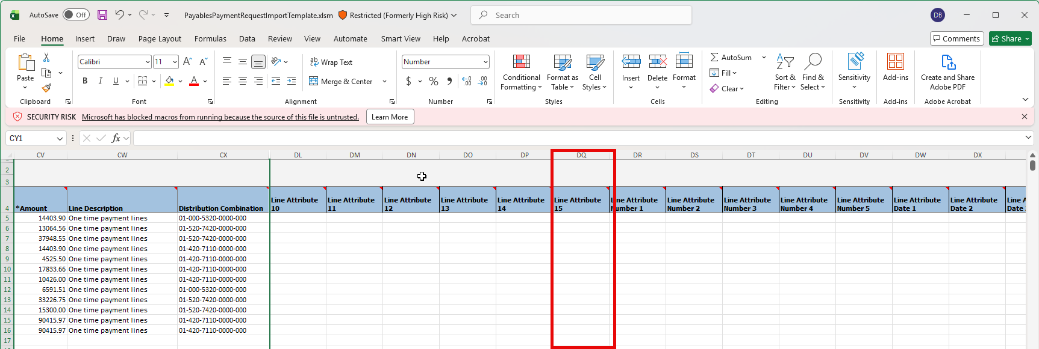
Party Payment Agency Upload-FBDI
This is the process agencies use to upload party payments.
Agencies can include accrual codes on this upload in column DQ (line level).
Note: Please be careful not to confuse with column CJ which is Attribute 15 at the header level.

Slide 31
Pcard Interface
Pcard Interface from BOA
Pcard interface will be paused on June 25th. Any invoices interfaced after this date will load in July and will not be accrued to the default accounts.
Agencies can manually flag lines of the invoice with accrual indicators, or they can use the Pcard Invoice Report RPT-AP-043 to filter for June purchase dates and enter a manual journal for accrual. Agencies should use NC AGY REVERSING ACCR journal category for these manual accruals.

Slide 32

NCFS Fixed Assets
Frank Newsom
NCFS Fixed Assets Lead
North Carolina Financial System
NC Office of the State Controller - OSC

Slide 33
Fixed Asset Accruals-July
The fixed assets module of NCFS will remain open until midnight July 26th
Agencies can capitalize assets for invoices keyed through that date
The fixed assets module will post the accrual (expense and liability) to the accrual ledger only
For any invoices that have been capitalized during this period agencies will need to remove the Accrual Indicator from the invoice so that the accrual will not be duplicated
Any asset transfers or asset retirements must be completed in the fixed assets module prior to July 26th. Asset additions and asset adjustments should be completed prior to July 26th, but can be backdated if deemed significant by OSC.
Note: These significant additions and adjustments completed after July 26th will be reconciling items on your fixed asset reports. Additionally, general ledger entries will be needed in FY26 & FY27 for the accrual ledger to correctly account for these late significant asset additions and adjustments.

Slide 34

Questions

Slide 35
NCFS Contact Information
NCFS Contact Center
  ncfs@ncosc.gov
  919-707-0795
  866-292-4314
NCFS Questions

Slide 36

NCFS Logo Closing

